Slide 1

SCHOOL OF COMPUTING
DEPARTMENT OF COMPUTER SCIENCE & ENGINEERING
1156CS601- MINOR PROJECT
SUMMER SEMESTER(2019-2020)
FINAL REVIEW
“SUBSIDY RATE PREDICTION FOR AGRICULTURAL CROP”
SUPERVISED BY
Dr.R.Kavitha
PRESENTED BY
1. Tanguturi Abhinay (VTU7240)(16UECD0064)
2. Nanabolu Manideep (VTU7254)(16UECD0046)
3. K Vamsi Krishna Reddy (VTU7228)(16UECD0032)

Slide 2
ABSTRACT
Agriculture is major occupation in India where 60% of people’s life is based on it, which contributes 6.1% in Gross Domestic Product (GDP) of India where Agriculture rank’s 11th place in the Indian economy has many problems to be dealt with.
Farmers can get the seeds for cultivation in subsidy rate but they can’t sell for subsidy rate. So, predicting the subsidy rate for a crop to be sold in market is very important.
Machine Learning techniques are used here, where the inputs are directly taken from the farmers and past data from the government region wise respectively.

Slide 3
TITLE JUSTIFICATION
India is a country where 60% of people depend on the Agriculture.
According to Statistics 6.1% Gross Domestic Product is contributed by Agriculture in our country. It holds 11th place in the Indian Economy.
In this Agriculture there are mainly 3 stages of crop development.
Crop to be cultivated and getting enough resources.
Farming and producing the crop qualitatively and quantitavely.
Selling and earnings based on the produced crop.
In all these 3 stages there are several problems to be dealt with.
Our Problem of subsidy rate prediction falls under 3rd stage of farming the crop

Slide 4
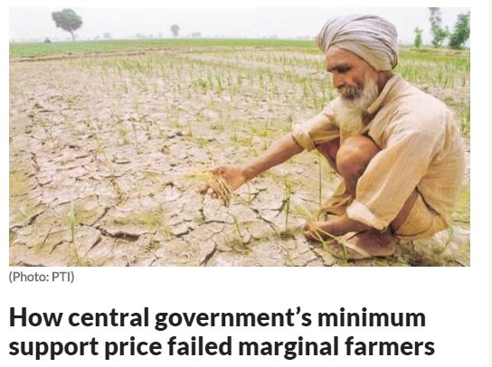
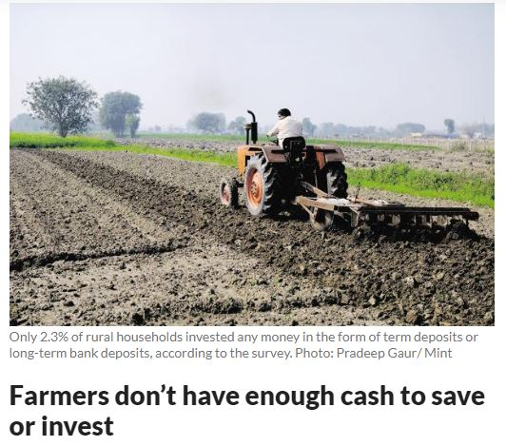
Farmer can’t fix the rate of the crop which he have cultivated for years to be sold in the market.
Government also doesn’t fix some subsidy rate for the crop to be sold. In this way the farmers are getting cheated by the people in markets and selling their crop for lower prices.

Slide 5
OBJECTIVES
The main objective is to predict the rate for the crop and to recommended the location in which a farmer can sell.
The old system should be changed such that our project helps them in predicting the rate and to sell in market where there is demand for the particular crop.
Area wise study is taken into consideration. According to that the Crop can also be exported to other areas.
This project has a future scope of developing an app or a website.
This project needs a more backend process where the Machine Learning Algorithm’s are trained for various types of inputs for acquring more accuracy.

Slide 6
INTRODUCTION
India is agriculture dependent country where the farmer’s are facing many problems in it.
The rate prediction for agricultural crop play’s a vital role in farmer’s life.
Predictive analytics is used here in which old methodologies and old data output’s study is used in finding the input attributes and training data.
By using these techniques it is easier to predict the subsidy rate accurately.

Slide 7
LITERATURE REVIEW
Tong Ai-hua,”Factors influencing prices of Agriculture products and stability counter measures” ,2012,Asian agricultural research.
This Paper presents counter measures and suggestions for stabilizing the prices of Agricultural Products based on Supply demand relationship, Promotion of production cost and circulation cost which leads to difficulty in sales of Agricultural products.
E Feng-jie,WANG Er-da,XIE Feng-yuan,” Crop Area Yield Risk Evaluation and Premium Rates Calculation—Based on Nonparametric Kernel Density Estimation”, 2009, International Conference on Management Science & Engineering.
This estimation is to evaluate the probability density of yield in 19 provinces of china per acre. Yield risk is also estimated on basis of normal density

Slide 8
Anil KUMAR Rohila,” Minimum Support Price to Farmers in India”, 2018,Popular Kheti
This paper mainly focus on the determination of MSP and major problems in implementing MSP. The major problem is that the Government is fixing the price at the beginning of the sowing season.
“Evaluation report on Efficacy of Minimum Support Prices (MSP) on Farmers”, 2016,NITI Aayog report.
This report is based on the recommendations of the Commission for Agricultural Costs and prices (CACP), Government of India, declares MSP for 22 crops before sowing season. This report conveys the impact of MSP and how it is monitored.

Slide 9
R S Deshpande,” IMPACT OF MINIMUM SUPPORT PRICES ON AGRICULTURAL ECONOMY”,2003, Agricultural Development and Rural Transformation Unit.
This paper is mainly focused on the impact and effectiveness of MSP on Agricultural economy in different states of India.
Shayequa Z. Alia, R.S. Sidhub, Kamal Vatta, “Effectiveness of Minimum Support Price Policy for Paddy in India with a Case Study of Punjab”,2012 Agricultural Economics Research Review.
This study helps in understanding the deviations in the Farm Harvest Price(FHP) and Minimum Support Price(MSP). In case of paddy, worked out examples proved the negative deviations in ineffectiveness of MSP.

Slide 10
Dr. Meenu Jain, ”Minimum Support Prices in India”, 2019, Indian Journal of Applied Sciences.
The need of MSP is that our population is increasing at less than 1 % while food production is growing at more than 3% which leads to fall in prices and income of the farmers.
Riplav Jain, Yash Jain, Manjunath C R , ” Estimating of Minimum Support Price (MSP) of Crops Using Data Analysis”, 2018,International Journal for Research in Applied Science & Engineering Technology.
This study focuses on the method of estimating MSP based on 2018 budget proposed by the government where MSP is 50% more than the weighted average cost of the production .

Slide 11
ARCHITECTURE DIAGRAM
Input Data
Data Processing
Data Evaluation
Regression Algorithm
Trained Data
Data Collection
Predicted Subsidy rate
Pre-Processing
Testing Data
Location for Selling the Crop

Slide 12
DATA FLOW DIAGRAM
Training Data Testing Data Input Data
Predicted Subsidy rate
Location for Selling the Crop
Regression Algorithm

Slide 13
Entity-Relationship Diagram
Investment
Crop Type
Region
Regression Algorithm
Data set
Crop Yield
Climatic Conditons
Demand and Supply
Region
Location Prediction
Predicted Crop Rate
Crop Rate
Crop Rate
Location

Slide 14
HARDWARE AND SOFTWARE SPECIFICATIONS
HARDWARE SPECIFICATION
Processor - Core i5 or i7 @1.70GHz 2.40GHz
RAM - 8 GB
Hard Disk - 10 GB
Key Board - Standard Windows Keyboard
Mouse - Two Button Mouse
SOFTWARE SPECIFICATION
Operating System- Windows 7,8,10
Coding Language- Python using Anaconda

Slide 15
IMPLEMENTATION
Initially the data is collected from the government websites for each and every input attribute.
In pre-processing stage the missing values and undefined values of the tables are cleaned and data is made legible for the algorithm to be used.
Evaluation of data is done by training the algorithm with the data available after Data collection and pre-processing.
In the evaluation 80% of data is taken for the training and 20% of the data is taken for the testing of the algorithm.
In the project the tables have the attributes namely cultivation cost1,cultivation cost2,yield,production rate, rainfall and predicted price for different types of crops in the different states of India.

Slide 16
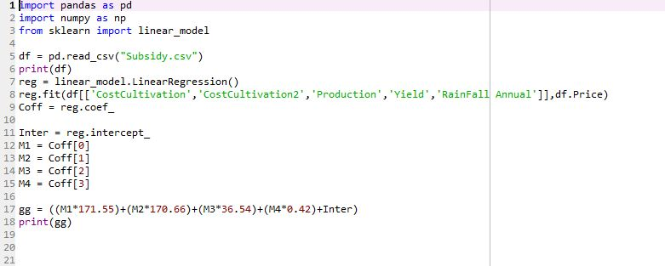
Regression algorithm
Regression algorithm is one of the finest algorithm used in Supervised learning and gives results more accurate in the case of predictive analytics.
In the project in training of the data Linear Regression function is used to plot the graph of predicted prices of the crop.

Slide 17
INPUT AND OUTPUT
Input to the project is the database with the attributes in CSV format such that the regression algorithm is trained.
In the input table price is also a attribute because Regression is supervised learning algorithm where the output variable is needed.
After training of the algorithm with the data then test data is given as input to the algorithm.
A GUI has been created because to make the project user friendly and easily accessed by the farmer’s
In the test data price is not one among the attribute such that it is predicted for the test data.

Slide 18
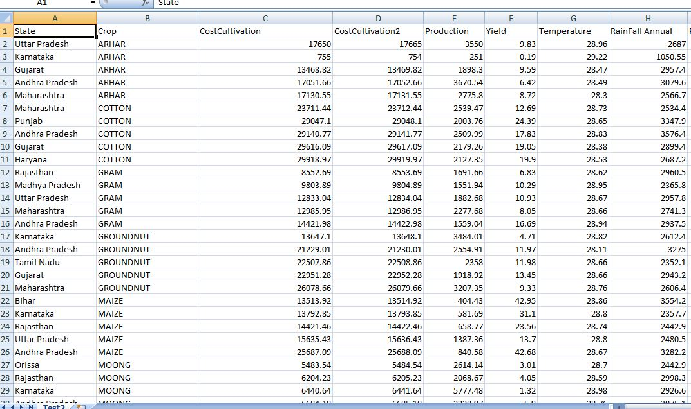
TEST DATA USED AS INPUT WITH 50 TUPPLES

Slide 19
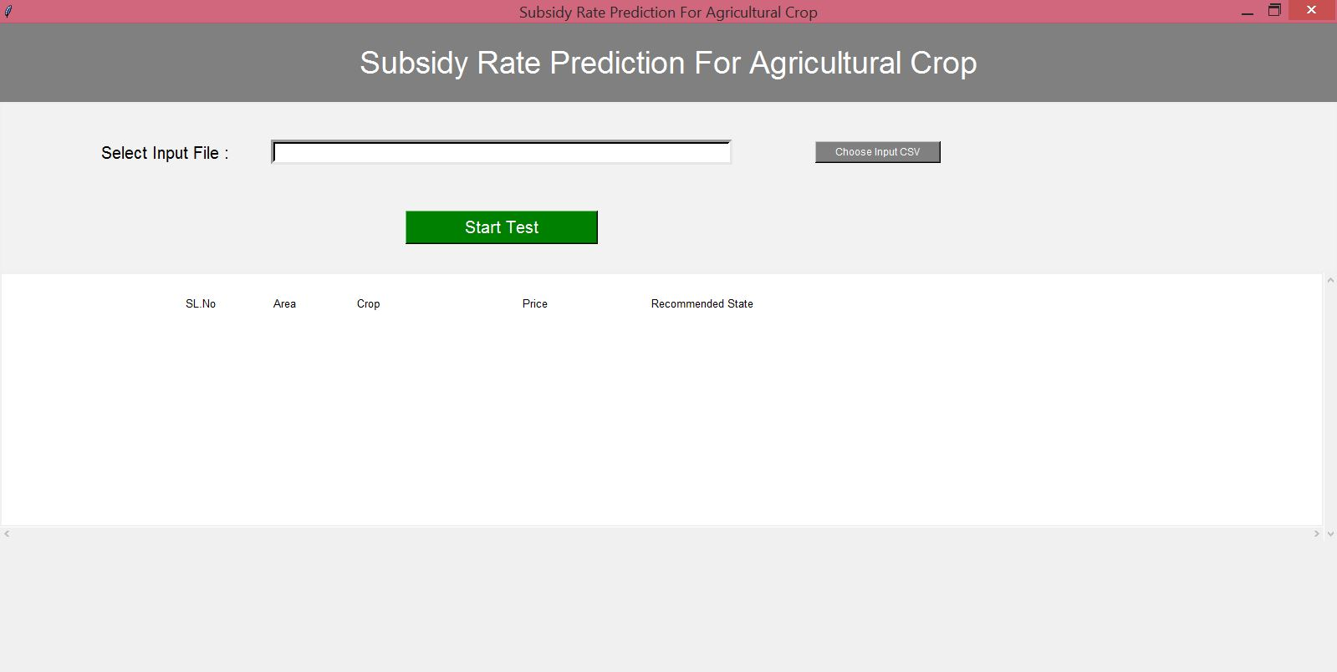
GRAPHICAL USER INTERFACE OF PROJECT

Slide 20
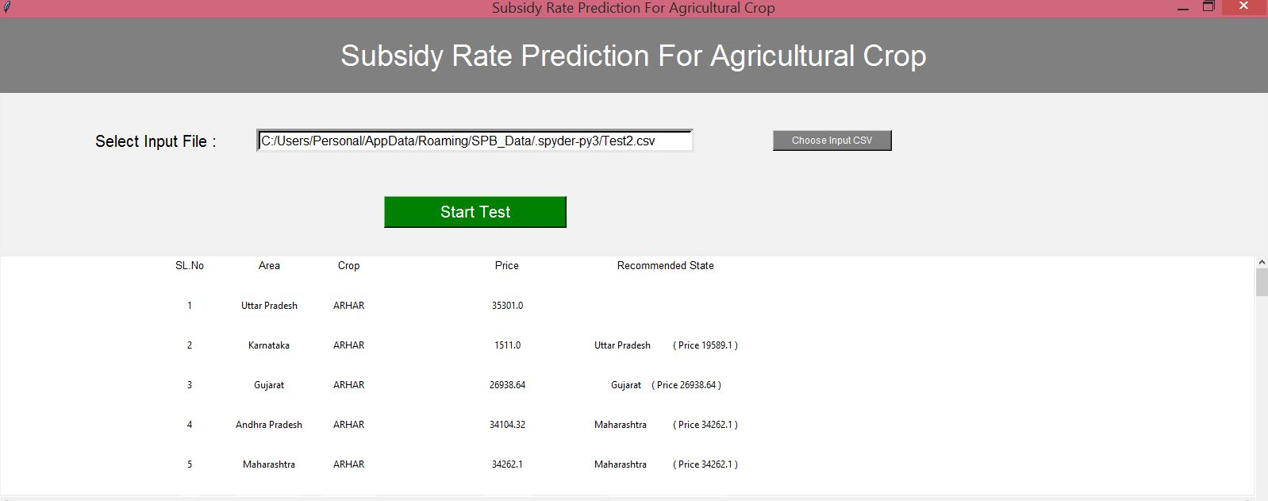
PREDICTED OUTPUT SUBSIDY RATE

Slide 21
CONCLUSION
According to the survey in the year 2018, the average death rate of farmers is more than 10 suicides per day.
The main reason for suicide is that the government is not providing subsidy rate for the farmers.
This project helps in predicting the subsidy rate for the crop which results in getting higher profits for farmers.
The high income results in giving a comfortable and a happy life to the farmer which intern develops the National Integrity.

Slide 22
FUTURE ENHANCEMENT
This project also can be developed into an app such that easily available to access.
The efficiency and accuracy of the result can be increased using the attributes in input data like demand supply rate, Market statistical analysis, Stock exchange etc.
These are time variant data’s changes on daily basis. There can be developed a cloud server such that the data modifications are done on the basis of need.

Slide 23
REFERENCES
Tong Ai-hua, “Factors influencing prices of Agriculture products and stability counter measures” ,Asian agricultural research 2012,4(4):17-19,43.
IE Feng-jie,WANG Er-da,XIE Feng-yuan,” Crop Area Yield Risk Evaluation and Premium Rates Calculation—Based on Nonparametric Kernel Density Estimation”, International Conference on Management Science & Engineering (16th) September 14-16, 2009.
Anil KUMAR Rohila,” Minimum Support Price to Farmers in India”, Popular Kheti , 2018,Volume -6, Issue-2 (April-June).
“Evaluation report on Efficacy of Minimum Support Prices (MSP) on Farmers”, DMEO report no.231, NITI Aayog, Development Monitoring and Evaluation Office, Government of India, New Delhi-110001, January, 2016.

Slide 24
R S Deshpande,” IMPACT OF MINIMUM SUPPORT PRICES ON AGRICULTURAL ECONOMY”, Agricultural Development and Rural Transformation Unit, Institute for Social and Economic Change,Nagarbhavi, Bangalore-560 072,December 2003.
Shayequa Z. Alia, R.S. Sidhub, Kamal Vatta, “Effectiveness of Minimum Support Price Policy for Paddy in India with a Case Study of Punjab”, Agricultural Economics Research Review, July-December 2012, Vol. 25(No.2) pp 231-242.
Dr. Meenu Jain, ”Minimum Support Prices in India”,Indian Journal of Applied Sciences, Volume-9, Issue-3, March-2019.
Riplav Jain, Yash Jain, Manjunath C R , ” Estimating of Minimum Support Price (MSP) of Crops Using Data Analysis”, International Journal for Research in Applied Science & Engineering Technology (IJRASET),Volume 6 Issue V, May 2018.

Slide 25


